Slide 1

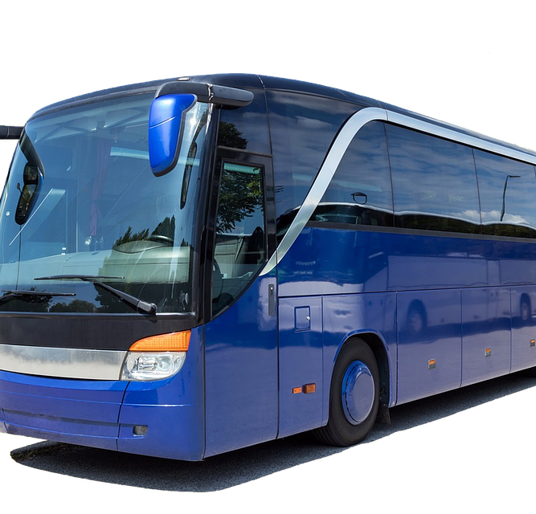

ONLINE BUS TICKET BOOKING SYSTEM (OBTBS)
Tirzah Grace.Y (21CS10071)
Ritesah Madhunala(21CS30042)
Cherukuri Tapaswini(21CS10018)

Slide 2


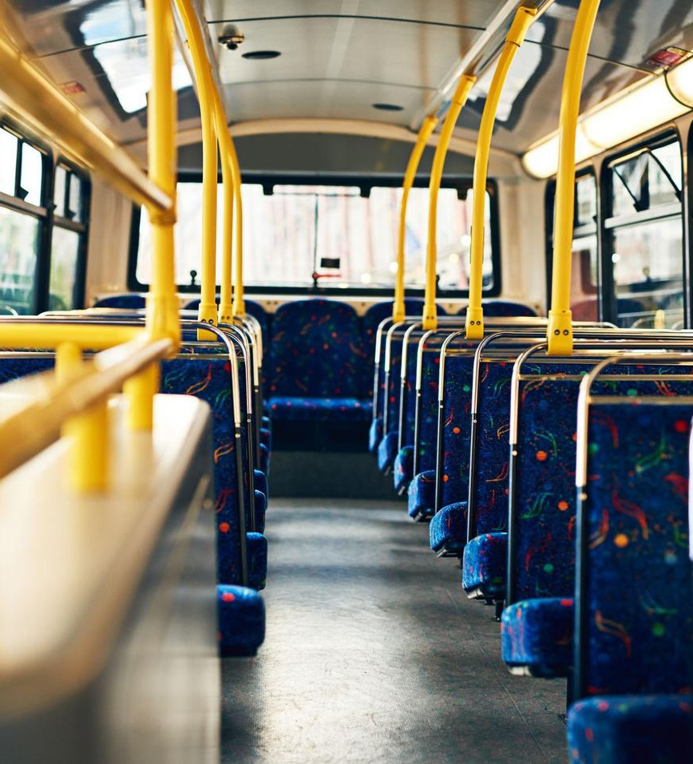
INTRODUCTION
An online bus ticket booking system is a convenient and efficient way for people to book bus tickets without having to physically go to a ticketing office or stand in long queues.
This system allows users to search for available buses, choose their preferred seats, and pay for their tickets all from the comfort of their homes.
The Online Bus Ticketing System (OBTS) empowers administrators to effectively manage various aspects of the system, such as buses, routes, users, and fares. With a user-friendly interface and intuitive functionalities, admins can seamlessly oversee and maintain these essential components, streamlining the entire process and ensuring efficient and effective operations.

Slide 3





PURPOSE
An online bus ticket booking application is of great importance in today's fast-paced world for several reasons.
Firstly, it provides a convenient and time-saving alternative to traditional ticketing methods, allowing people to book and manage their bus travel plans from anywhere, at any time, and on any device with an internet connection.
This saves customers valuable time and effort that they would have otherwise spent physically visiting a ticketing office and standing in long queues.

Slide 4



IMPORTANCE
This application provides real-time updates on bus schedules and seat availability, allowing users to make informed decisions and plan their trips accordingly.
This is particularly important in today's fast-paced world, where people are constantly on the move and need to make quick decisions about their travel plans.
An online bus ticket booking application helps to reduce the environmental impact of travel by reducing the need for physical ticketing offices and paper tickets. This aligns with the growing trend towards sustainability and responsible travel practices.

Slide 5




Key features
The key features of an online bus ticket booking system typically include:
User registration and login: Users can create accounts and log in to the system to access various features and functionalities.
Bus route search: The system allows users to search for available bus routes based on their departure and arrival locations, dates, and times.
Seat selection: Users can select their preferred seats on the bus and view the available seats on a seat map.
Admin Login: Admin manages buses, route details such as( from, to ,date, time, fares),
users, can track sales , seats filled.

Slide 6
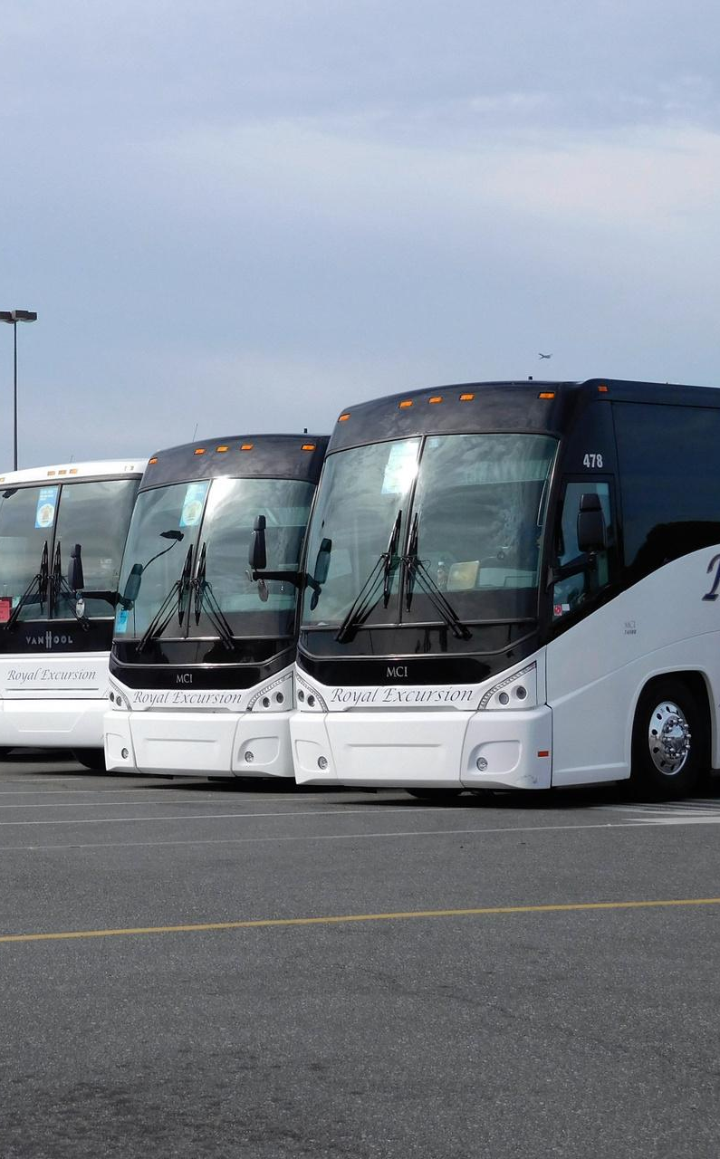




Key Features
Scheduled updates: The system provides scheduled updates on bus schedules, route changes, and delays .
Customer support: The system provides customer support through email.
Admin panel: The system includes an admin panel that allows the system administrators to manage bus routes, schedules, fares, and user data.
Features enable users to book and manage their bus travel plans efficiently and conveniently while providing administrators with the necessary tools to manage the system effectively.

Slide 7



PHP AND MYSQL
PHP and MySQL are commonly used in making Online Web Applications due to their many advantages and functionalities.
PHP is a server-side scripting language that is widely used for web development. It is open-source, free, and easy to learn, making it an attractive option for developers.
MySQL is an open-source relational database management system (RDBMS) that is widely used for web applications. It is known for its scalability, reliability, and security features, making it an ideal choice for handling large amounts of data.
PHP and MySQL are both open-source technologies, which means that they are free to use and distribute. This makes them an economical choice for developers and businesses.

Slide 8




PHP & MYSQL
PHP has built-in functions and libraries that enable developers to perform various tasks quickly and efficiently, such as handling form data, processing payments, and sending email notifications.
MySQL provides a secure and reliable way to store and retrieve data, which is critical for an online bus ticket booking system that handles sensitive customer information.
PHP and MySQL are highly compatible with other web technologies, such as HTML, CSS, and JavaScript, allowing developers to create dynamic and interactive web applications.
Overall, PHP and MySQL are widely used in making online bus ticket booking system because they are powerful, flexible, and easy to use, enabling developers to create efficient and reliable systems that meet the needs of businesses and customers.

Slide 9
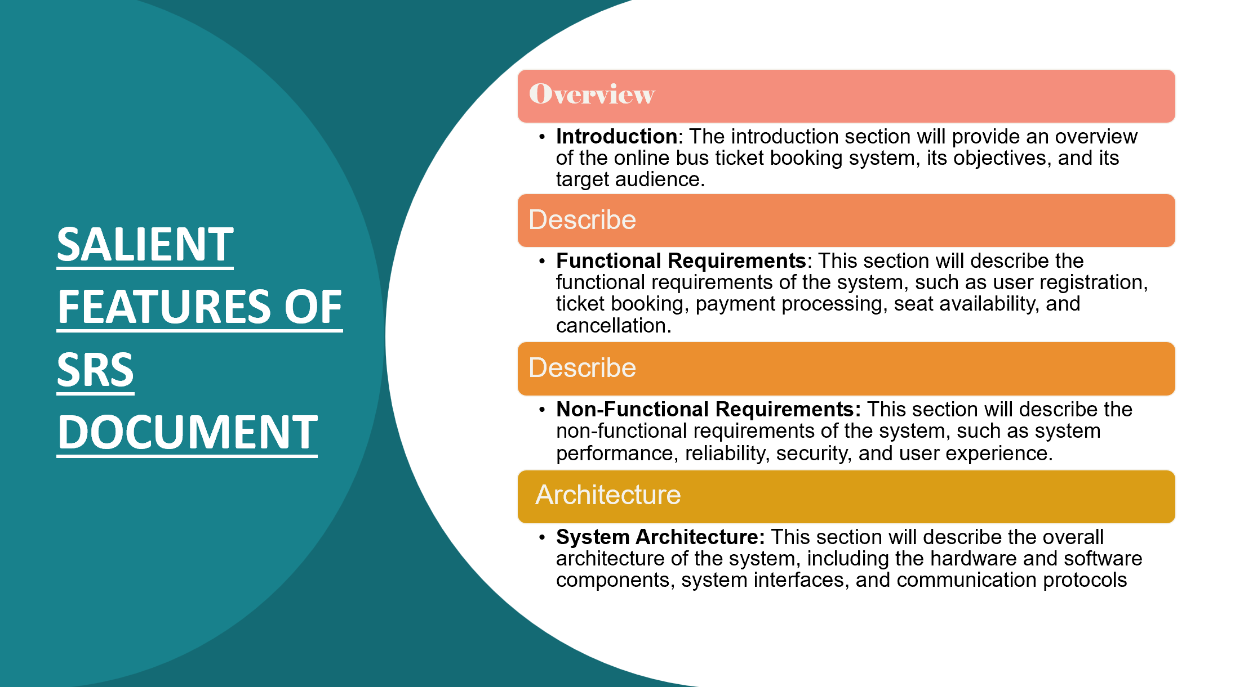

Slide 10




SALIENT FEATURES OF SRS DOCUMENT
User Interface Design: This section will describe the user interface design of the system, including wireframes, and usability requirements.
Data Model: This section will describe the data model of the system, including the data entities, attributes, and relationships.
External Interface Requirements: This section will describe the external interfaces of the system, including the user interfaces, hardware interfaces, and software interfaces.
Constraints: This section will describe any constraints that may impact the development or implementation of the system, including hardware, software, and environmental constraints.

Slide 11


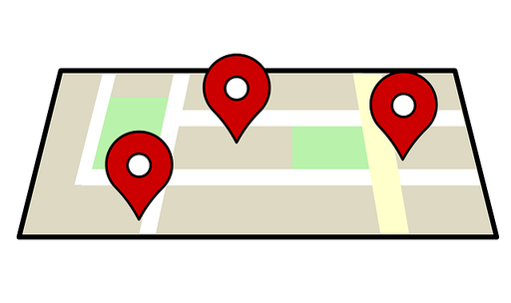

MAIN PAGE FEATURES
Looking for Information on the Website
Website Navigation
From and To Destination Search
From and To Destination Search Results Download
About Us: This menu item will provide information about the website developers, their mission.
Feedback Submission
Admin & User Login

Slide 12
ADMIN PAGE FEATURES
Dashboard Visibility
Bookings : Search based on Name and/or contact, Add or Delete a booking
Bus Details : Search(Using Bus Number) , Edit, Delete, Add Details
Admin Details : Search (Using Username) , Add Details, Delete Account
Seats : Search for Seats Booked based on Route-ID
Sales : Total Sales on Bookings On a Bus and/or On a Date
Customers Details : Search( By Name, Contact) , Add, Delete
Routes Details : Search ( By From Destination, To Destination, Bus Number, Departure Date, Departure Time, Cost ), Edit , Delete, Add Details

Slide 13

USER PAGE FEATURES
Buses Details: Search(Using Bus Number)
Routes Details: Search (Using From Destination,& To Destination)
Booking: Search(By From Destination & To Destination), Choose Bus, Choose Seat, Payment
Booking Details: Customer Details, Booking ID, Bus Details, Route, Cost, Cancel Booking
Dashboard Details: Total Bookings, Total Buses, Total Routes

Slide 14
CHALLENGES FACED
Understanding PHP & MYSQL framework
The system should be designed to provide a seamless and intuitive user experience, which can be a challenge, especially when catering to users with varying levels of technological proficiency.
Maintenance: Online bus ticket booking systems require regular maintenance and updates to ensure that the system runs smoothly.
Integration with third-party services: OBTBS may require integration with third-party services, such as payment gateways, SMS gateways, and mapping APIs. Integration with these services can be complex and may require specialised knowledge.

Slide 15
FUTURE DEVELOPMENTS
FUTURE DEVELOPMENTS
Multiple bookings can be done by a Single User
Analytics and reporting: The system generates reports and analytics on user behaviour, ticket sales, revenue, and other key performance indicators to help the administrators make informed decisions.
Delete user account if (s)he wishes to
Implementing actual Payment Gateway
User Can Cancel a ticket he booked in a stipulated time
Overall, implementing these future developments could help to improve the user experience, increase customer satisfaction, and differentiate the system from competitors.

Slide 16

CONCLUSION
In summary, an online bus ticket booking system is a web-based application that allows users to search and book bus tickets online.
The purpose of the system is to provide a convenient and user-friendly platform for users to book and manage their bus travel plans. The key features of the system include a user-friendly interface, real-time seat availability, and booking history.
PHP and MySQL are used to develop the system due to their ease of use, flexibility, and compatibility.
Security measures such as secure login, encryption, and regular backups are essential to protect user data and transactions.

Slide 17

Thank you

